Slide 1
HR Analytics Case Study
Robert Danielson
Isaac Winters
Greg Norman
Siwoo

Slide 2
Problem
HR Data Analytics
https://www.kaggle.com/vjchoudhary7/hr-analytics-case-study#general_data.csv
How can a company determine if a person is more likely to leave?
Machine Learning Methods: Linear Regression, Random Forest, Gradient Descent

Slide 3
Data Variables
Age
Attrition
Business Travel
Department
Distance From Home
Education
Education
Education Field
Employee Count
Employee ID
Gender
Job Level
Job Role
Marital Status
Monthly Income
Number of Companies Worked
Total Working Years
Years With Current Manager

Slide 4
Random Forest
Import Dependencies: Pandas, Numpy, Seaborn, SQLite
Clean Dataset
Drop Useless Columns
Convert “Monthly Income” Column From Indian Rupees to USD
Copy Categorical Data
Produce Random Forest Model

Slide 5
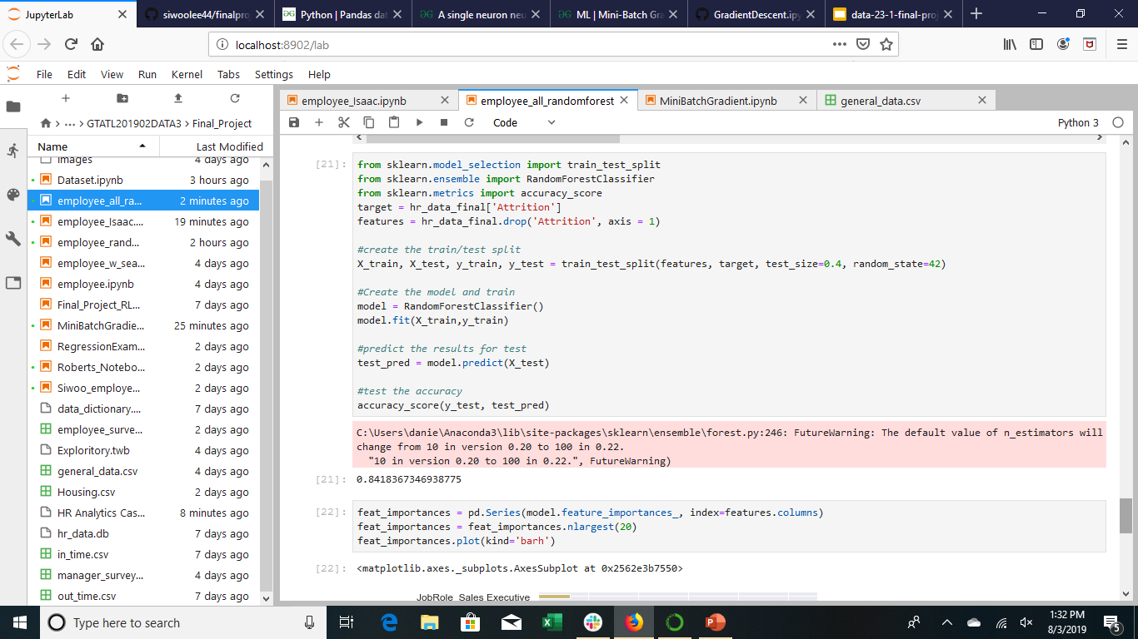
Random Forest

Slide 6
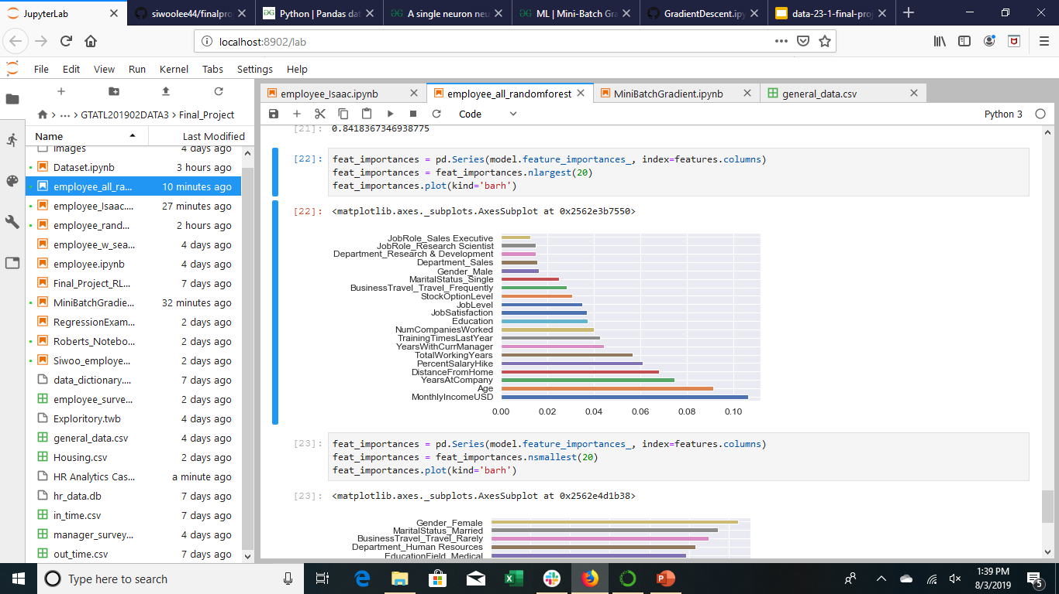
Attrition Rate

Slide 7
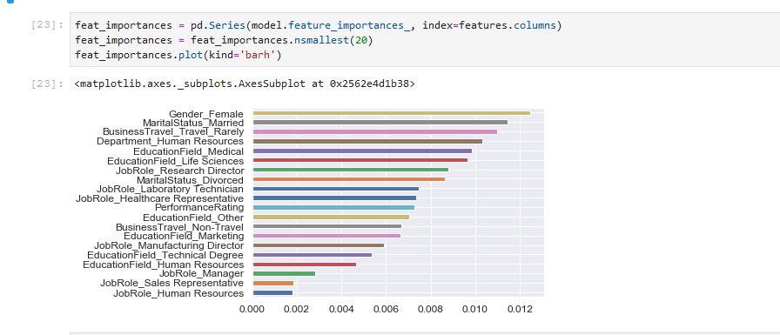
Attrition Rate

Slide 8
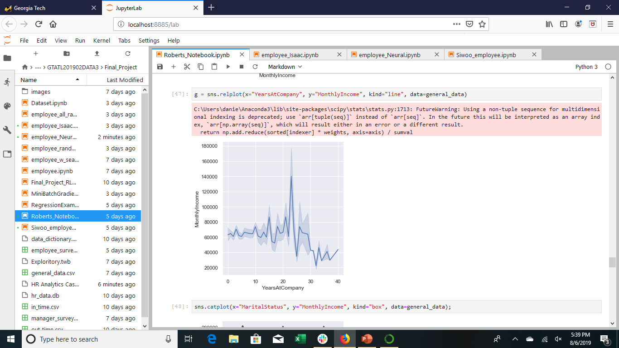
Monthly Income Vs Years At Company

Slide 9
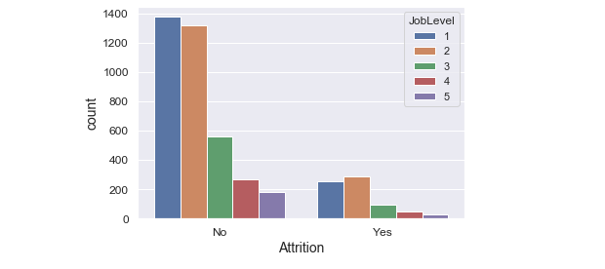
Job Level Vs Attrition

Slide 10
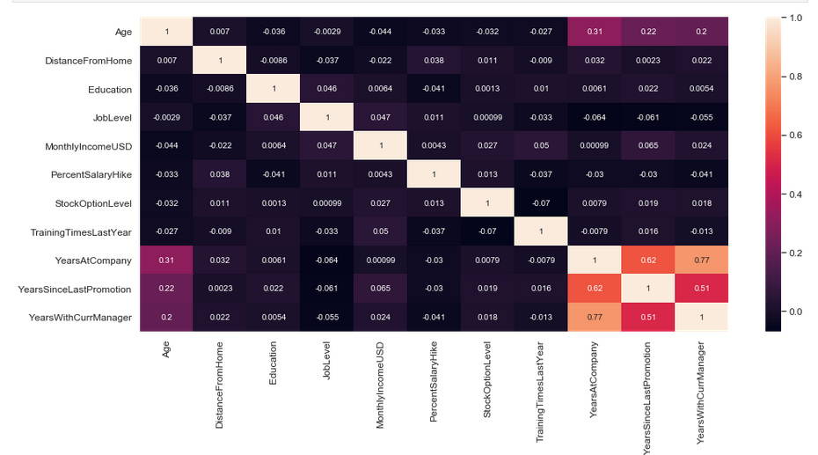
General Data

Slide 11
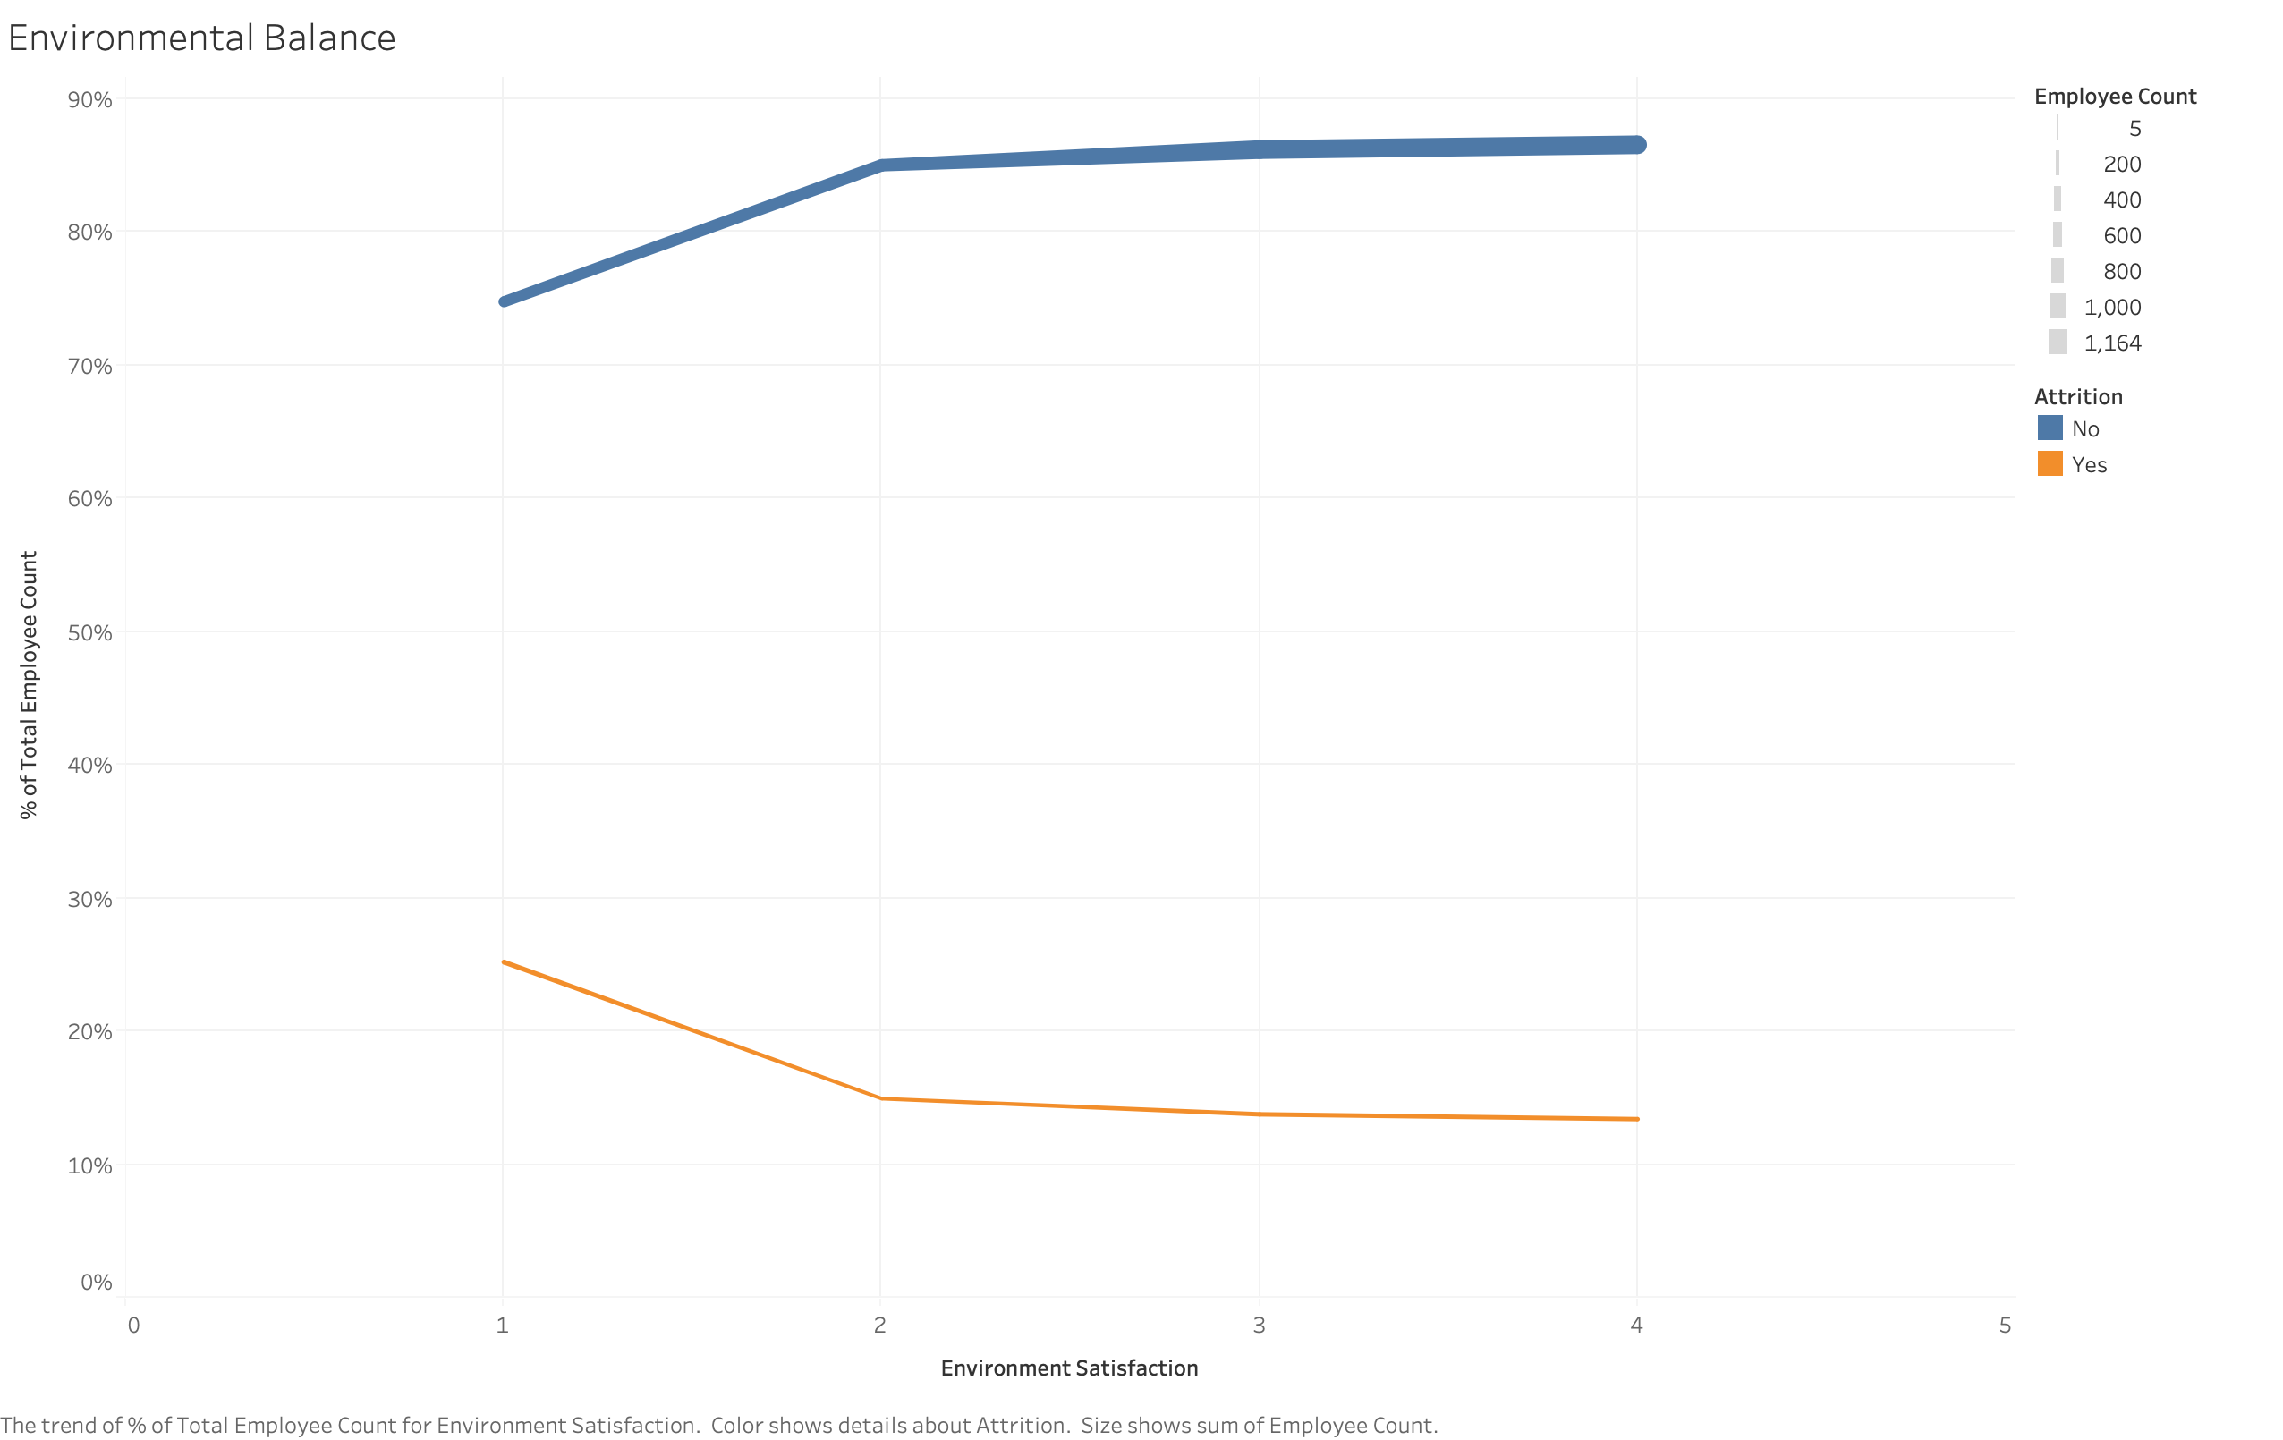
Environmental Balance
Low = 1
Medium = 2
High = 3
Very High = 4

Slide 12
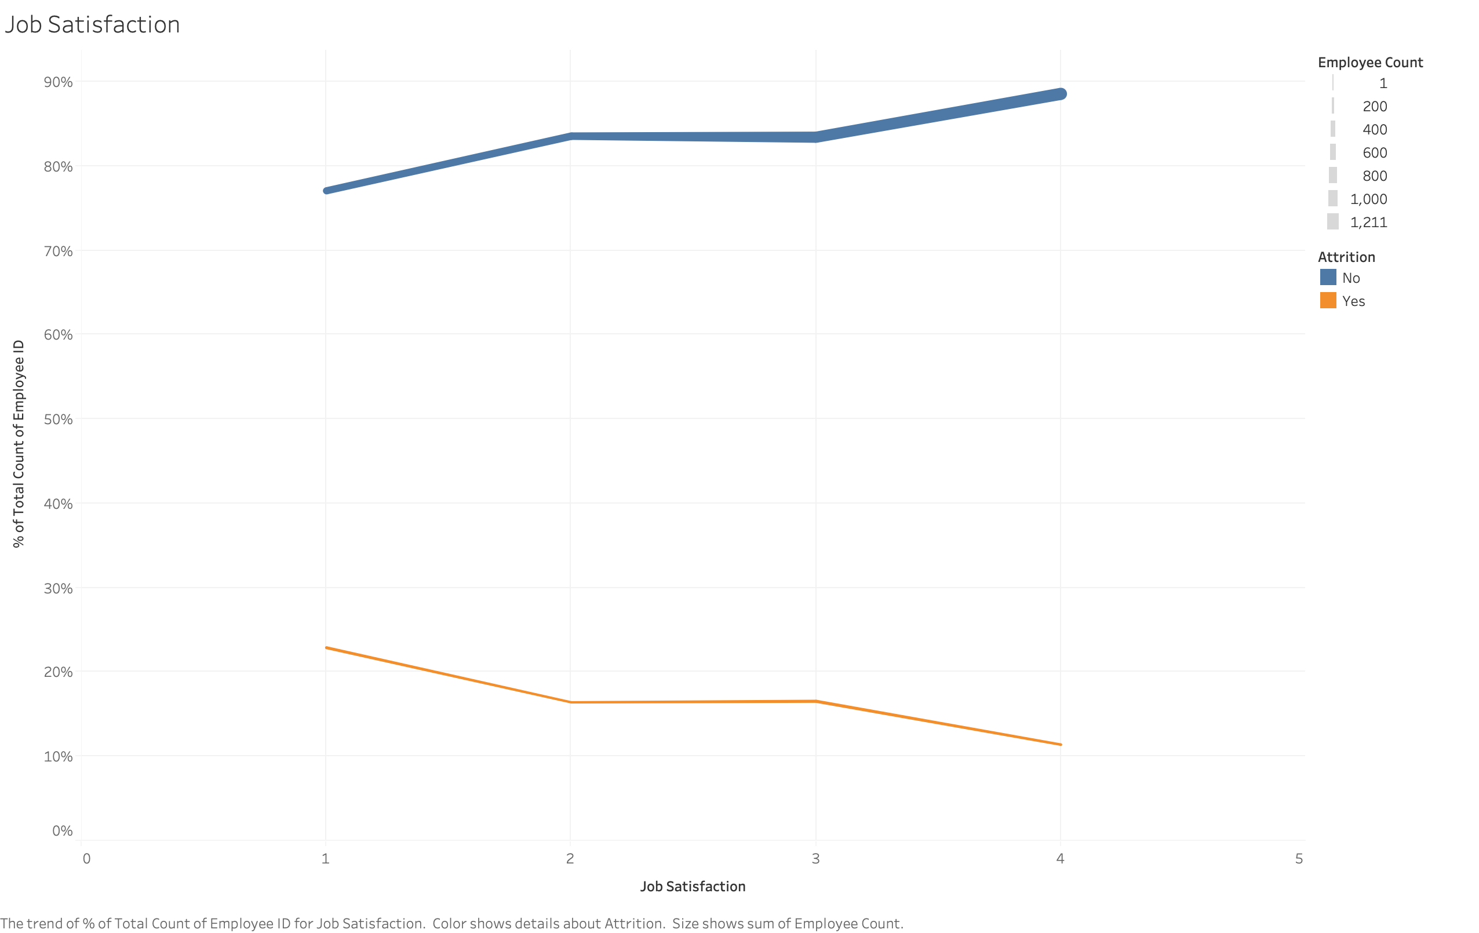
Job Satisfaction
Low = 1
Medium = 2
High = 3
Very High = 4

Slide 13
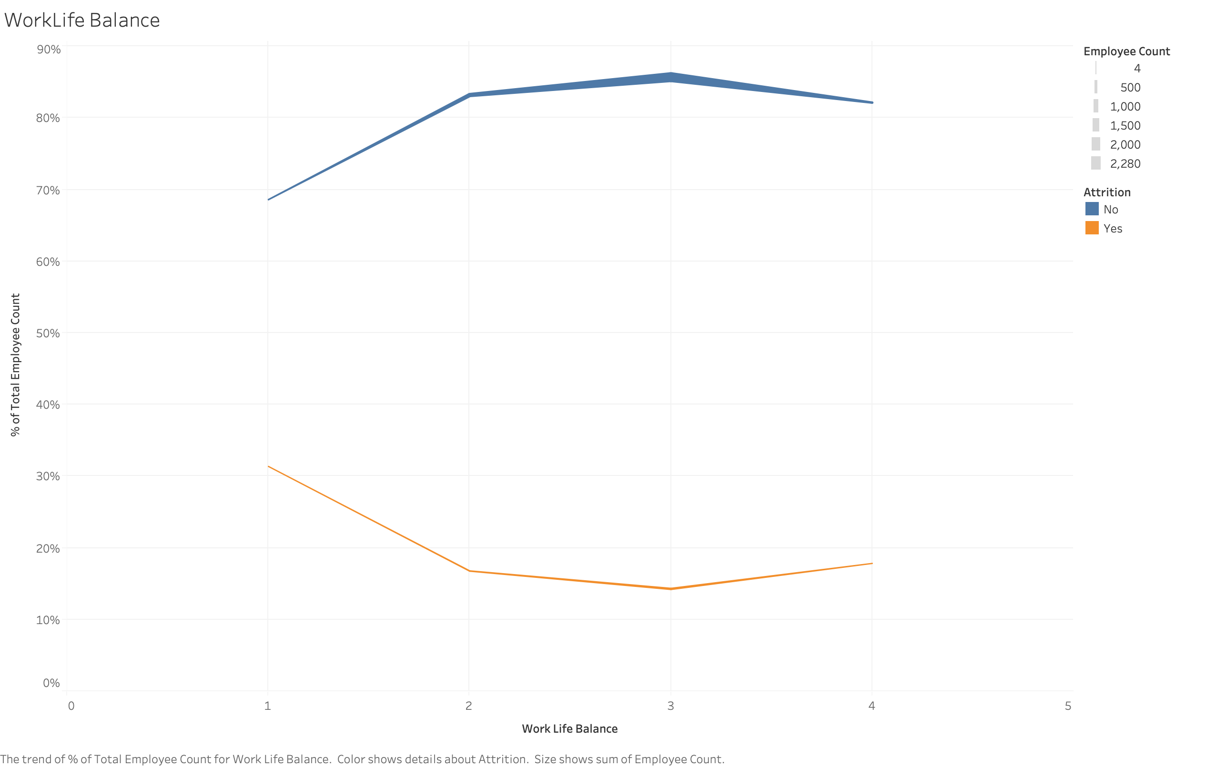
Work Life Balance
Bad = 1
Good = 2
Better = 3
Best = 4

Slide 14
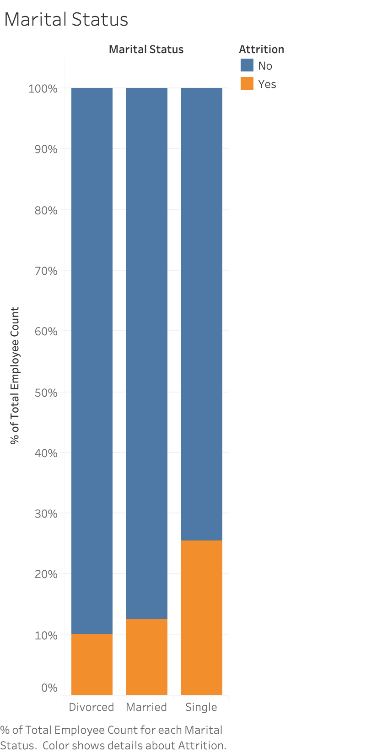
Marital Status

Slide 15
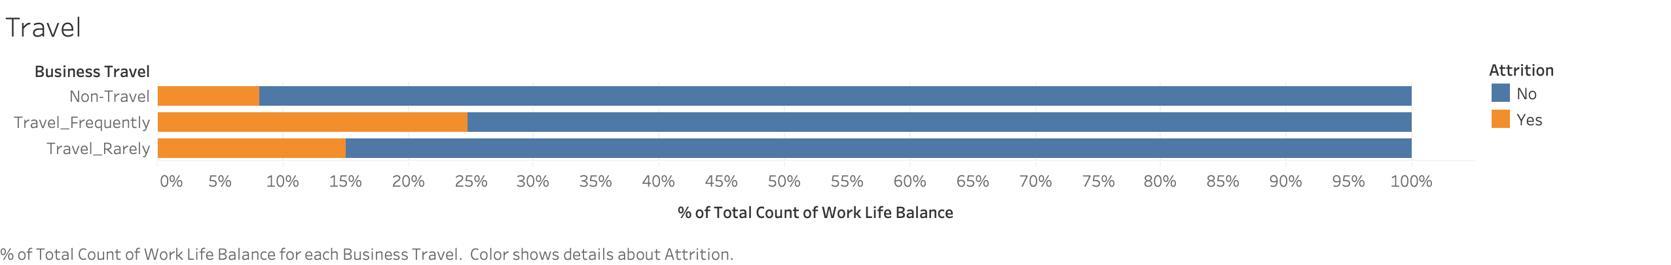
Travel Rate

Slide 16
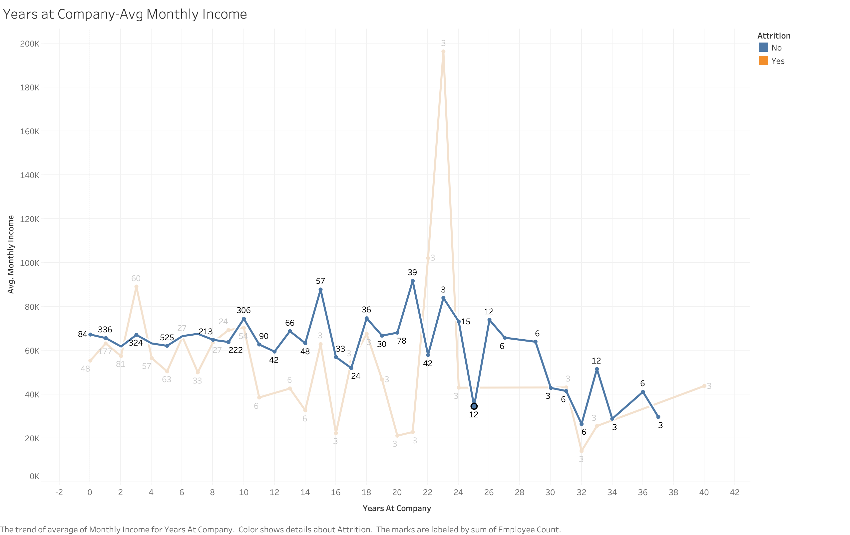
Monthly Income

Slide 17
Conclusions
Monthly Income is #1 Factor in Attrition Rate
25% Attrition Rate of “Travel Frequently” Employees
Divorced People Leave The Least

Slide 18
Questions?

